Slide 1
NIRSpec/NIRCam Data Reduction
JADC workshop Melbourne November 2025

Slide 2
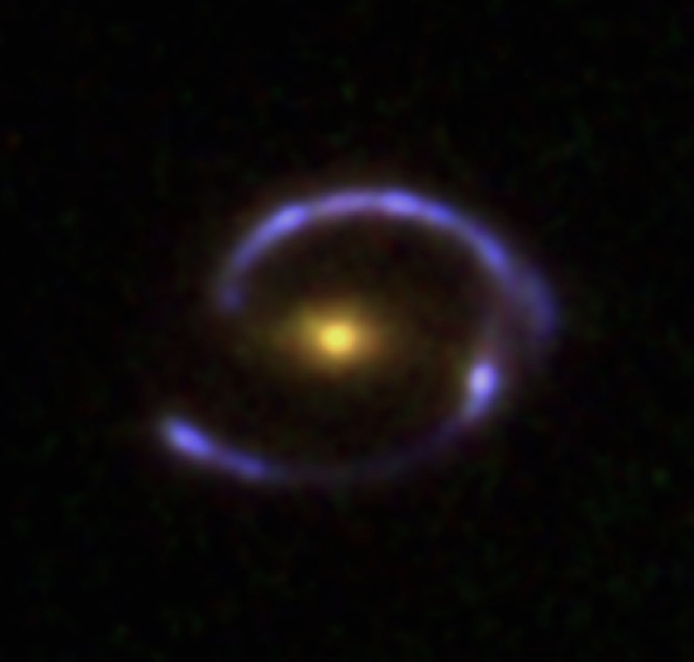
Our target: The Cosmic Eye
A Gravitationally Lensed Galaxy!
Source redshift = 3.07331, magnified by a factor of ∼25 by z= 0.73 deflector galaxy (Quider et al. 2010)
Has NIRCam and NIRSpec IFU observations from cycle 2 program # 4125 (PI Florian).

Slide 3
NIRSpec/IFU

Slide 4
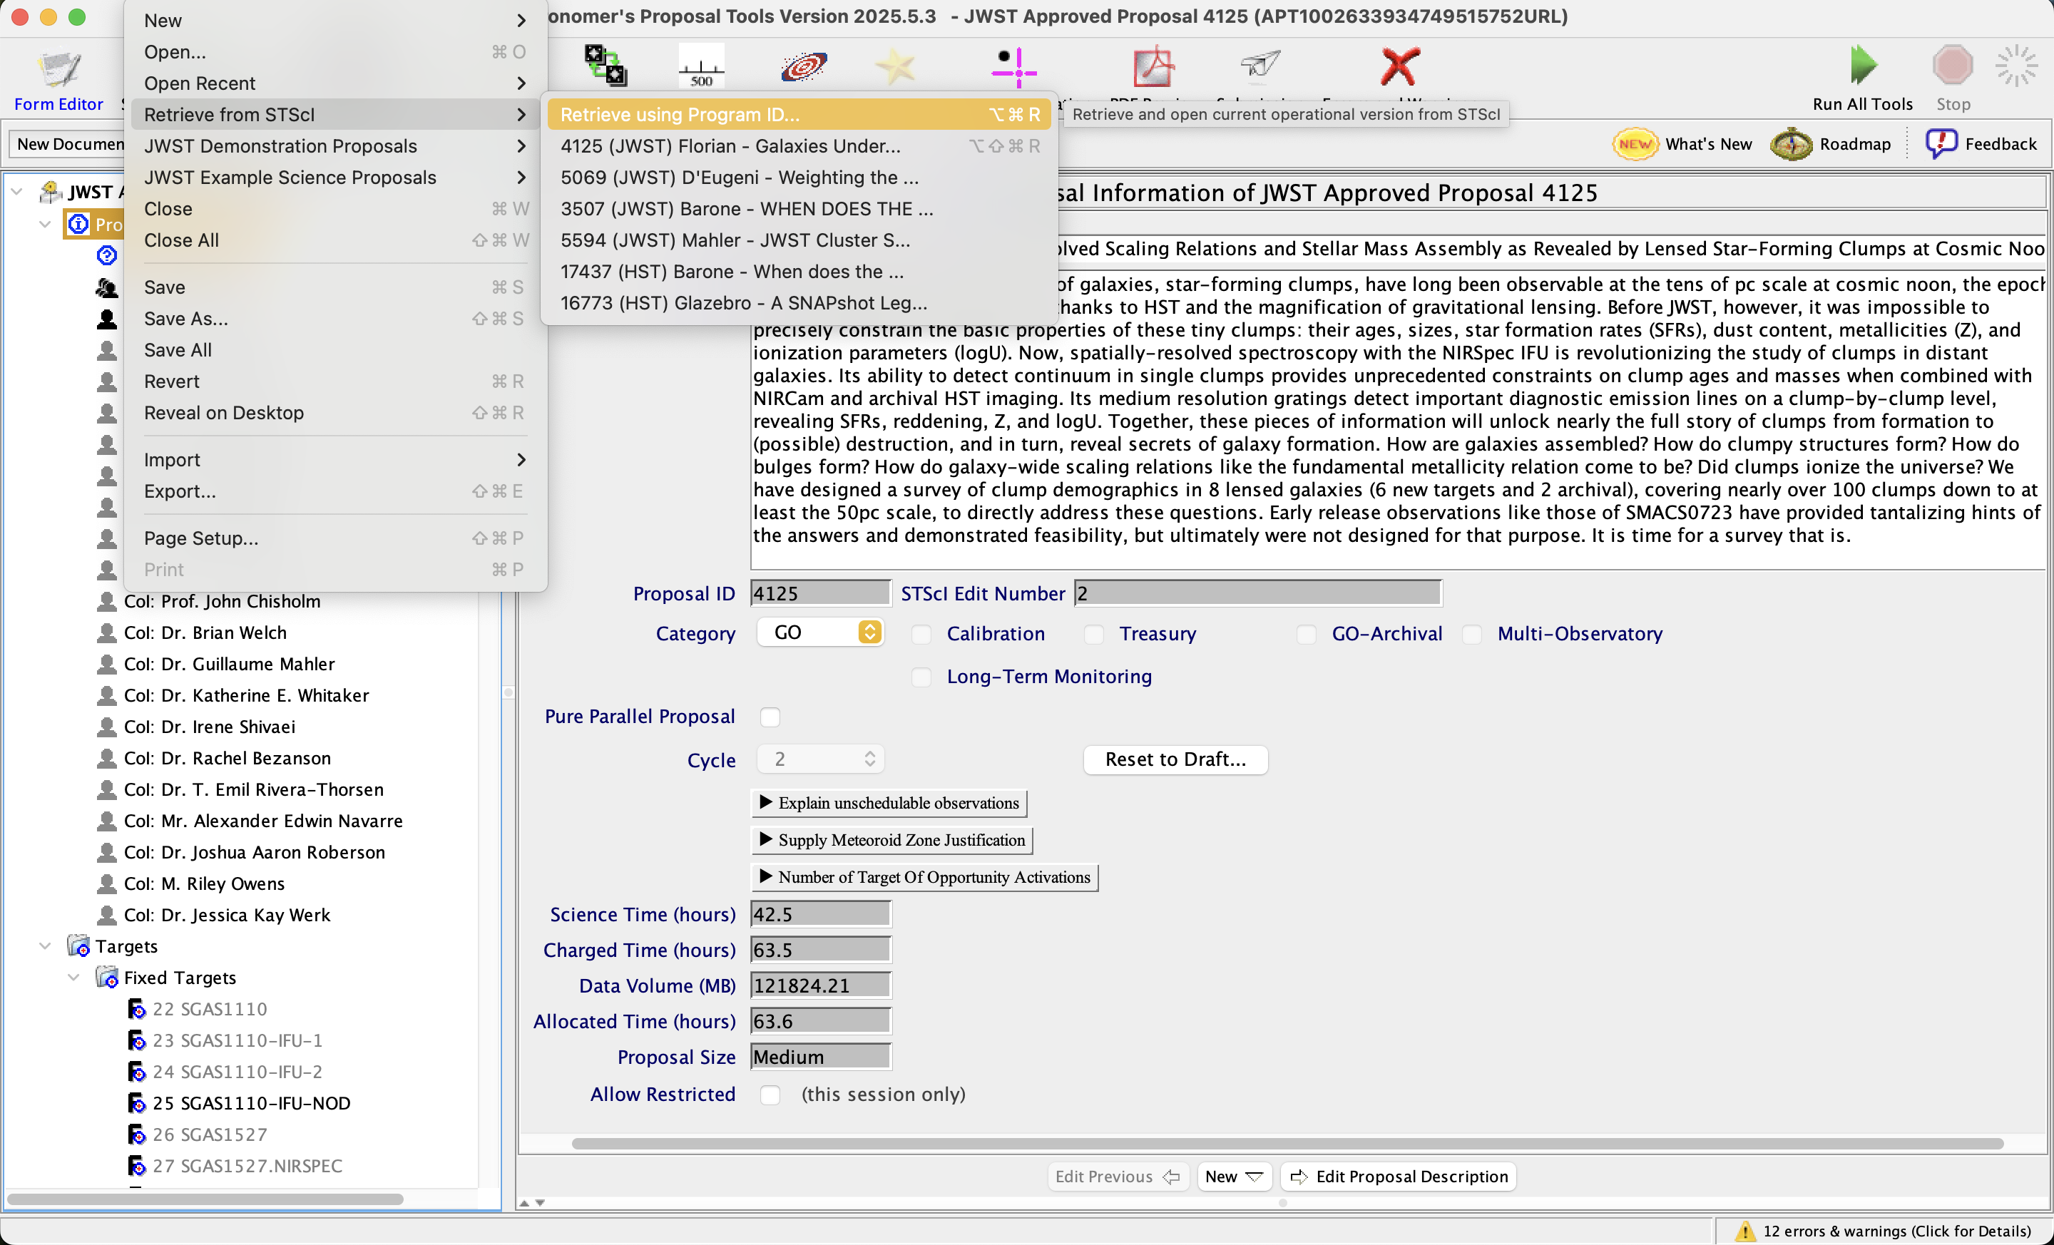
Look up Proposal information on APT
APT files for accepted programs are public.
File > Retrieve from STScI > Retrieve using Program ID
Program ID = 4125

Slide 5
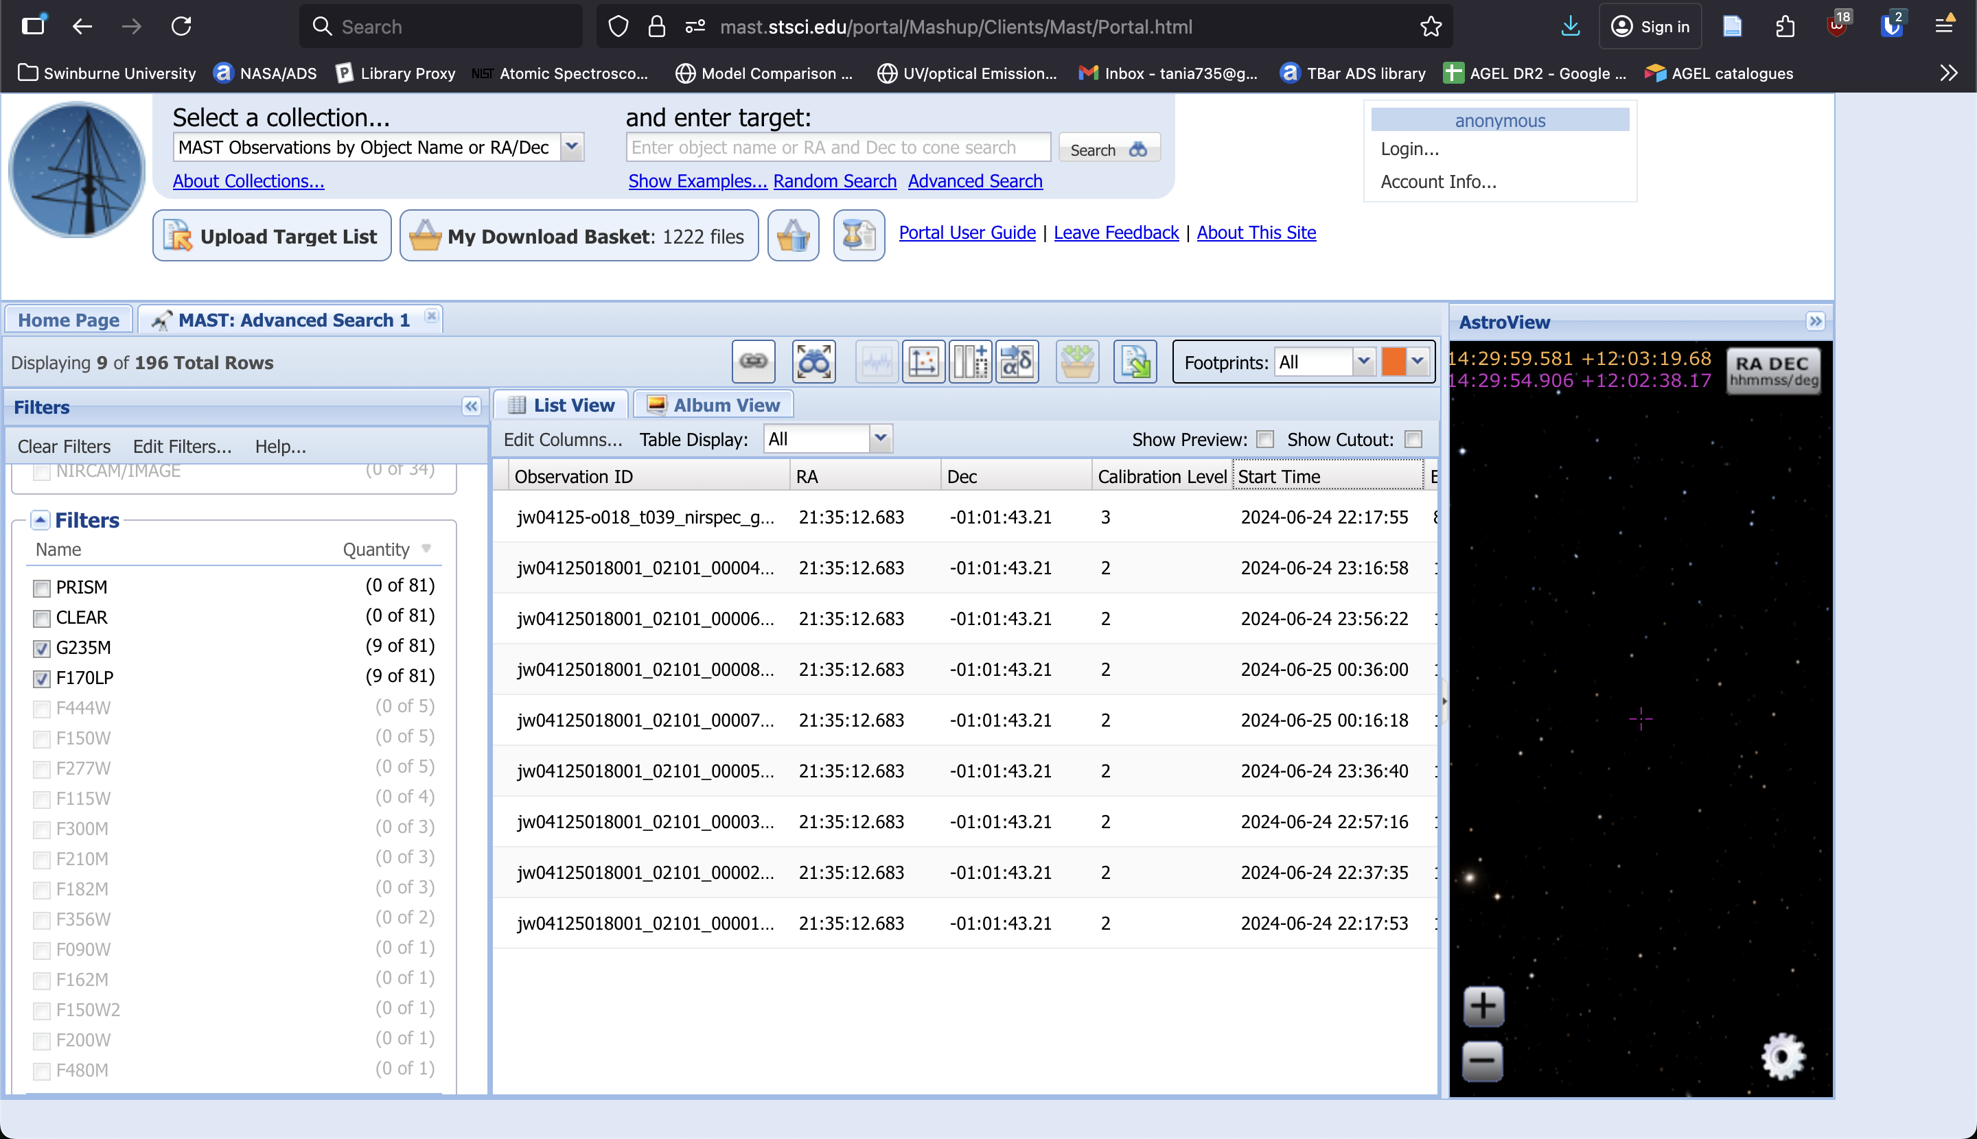
Retrieve data from MAST
Select G235M/F170W (the medium resolution grating with 1.7 micron filter)
There are 8 dithers = jw04125018001_02101_0000X_nrs2 for X = 1-8
Fully reduced cube = jw04125-o018_t039_nirspec_g235m-f170lp

Slide 6

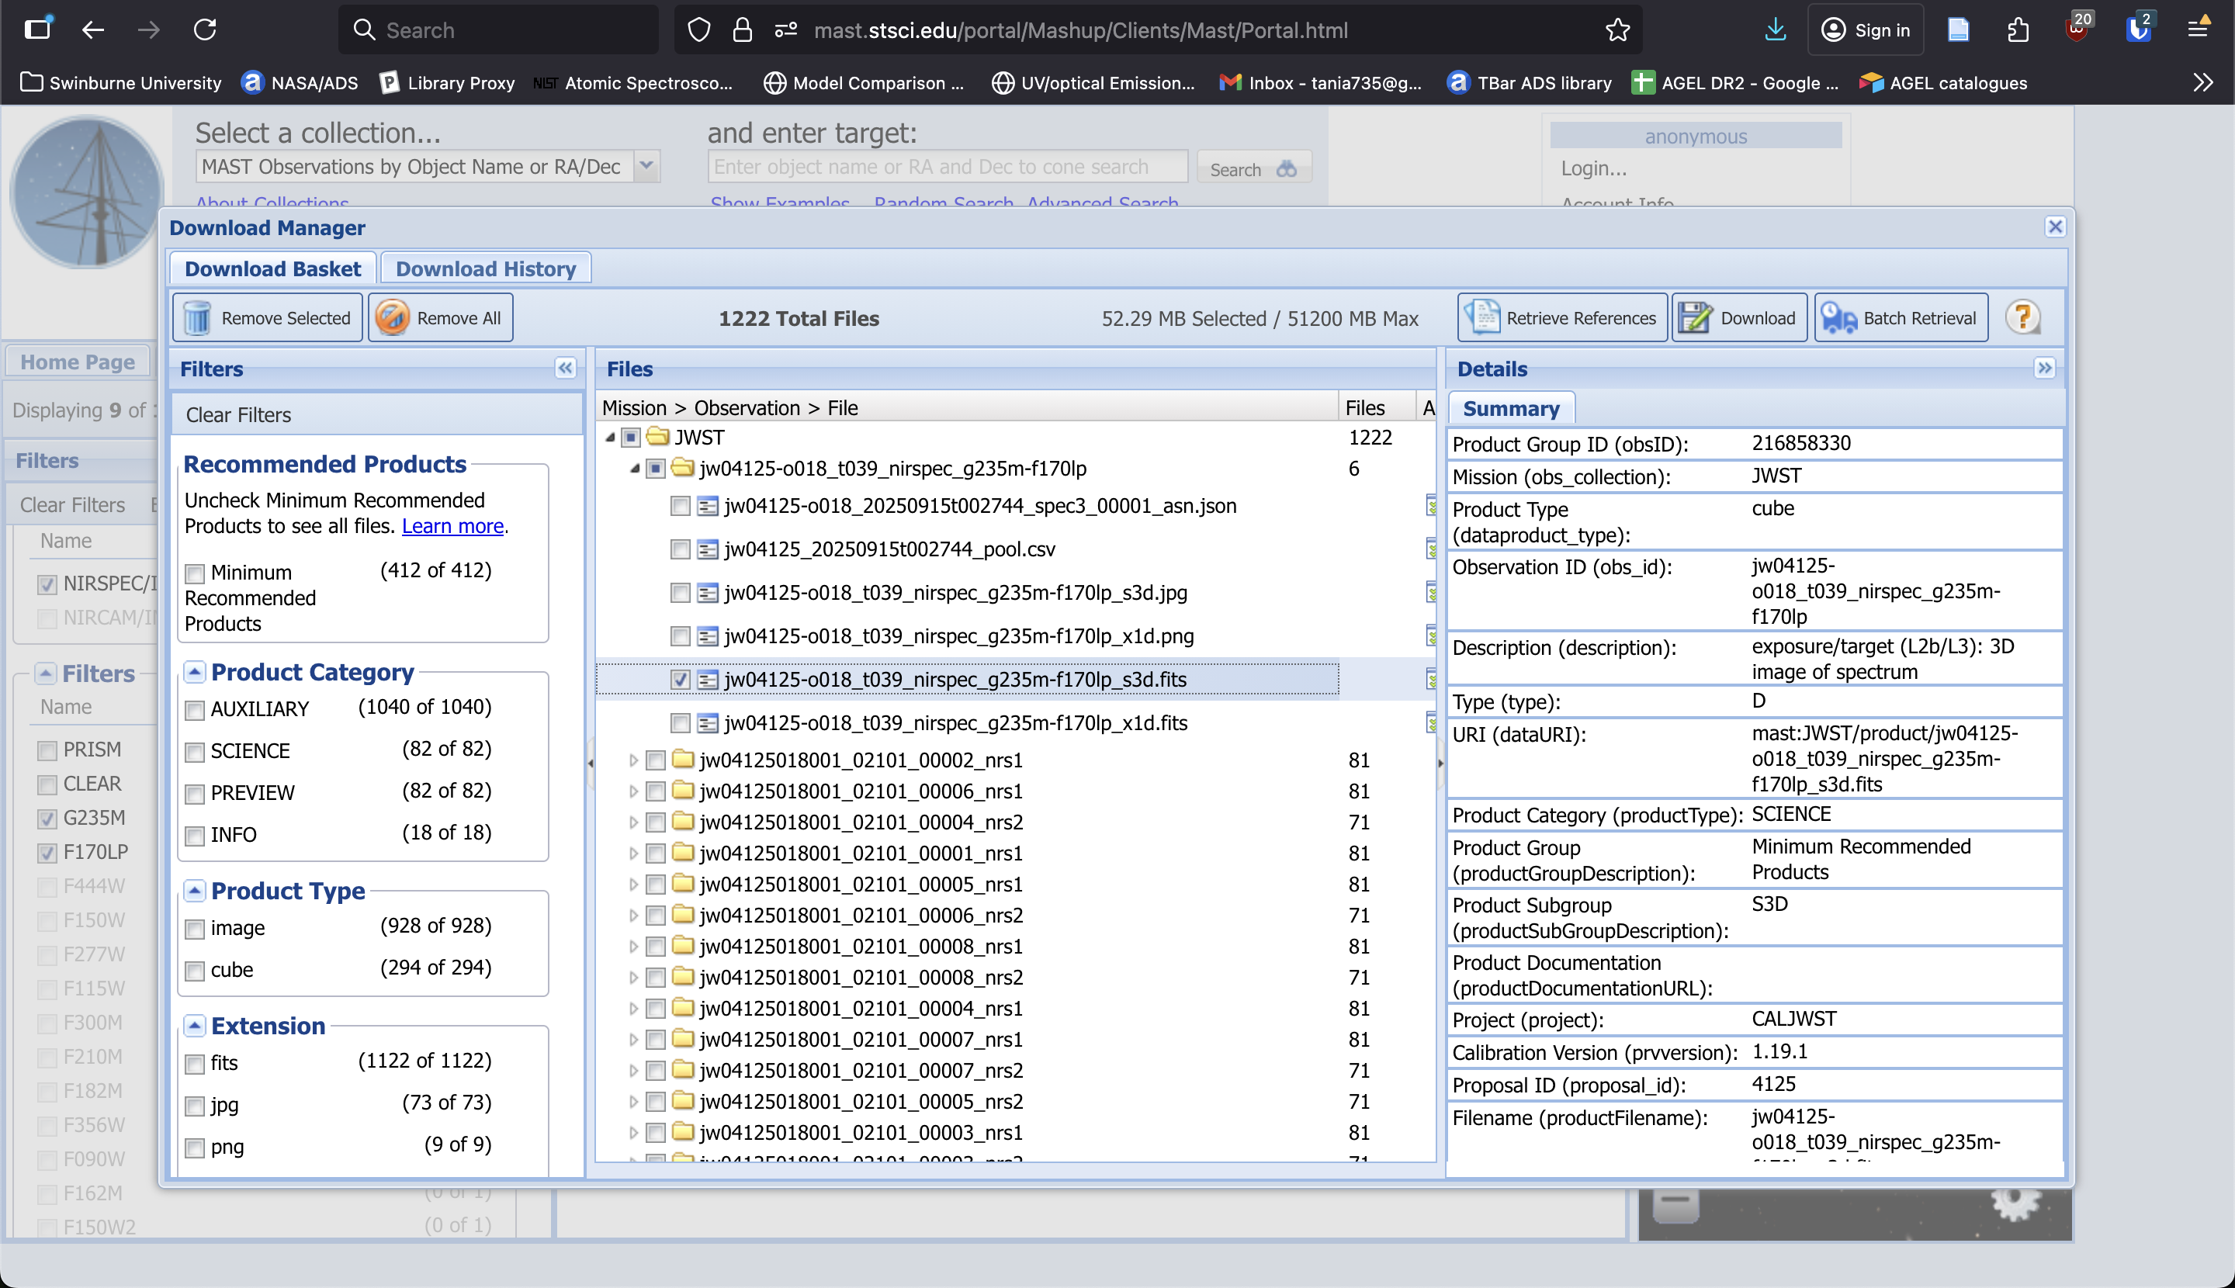
Download the reduced cube
Filename = jw04125-o018_t039_nirspec_g235m-f170lp_s3d.fits
JWST proposal ID
Association candidate ID
Target ID
Instrument, grating, filter
filetype (spec 3D)
File naming convention: https://jwst-pipeline.readthedocs.io/en/latest/jwst/data_products/file_naming.html

Slide 7

Download the raw* exposures
Raw (stage 0 from the telescope) = _uncal.fits
Stage 1 produces _rates.fits
Stage 2 produces _cal.fits
Stage 3 produces _s3d.fits
Stage 1 of the pipeline requires GBs of reference files, will take too long to download so we’ll start at stage 2. Download _rates.fits files
The NIRSpec G235M/F170LP grating/filter combination uses only the first (nrs1) of NIRSpec’s two detectors (nrs1 and nrs2). Only download the NRS1 files.
To speed up downloads and reduction, only download the first two exposures (1 – 2):
jw04125018001_02101_00001_nrs1_rate.fits
JWST proposal ID
Observation number
Visit number
visit group, sequence,
Exposure number
Detector
File type
Notes:
jw04125018001_02101_00001_nrs1_rate.fits

Slide 8
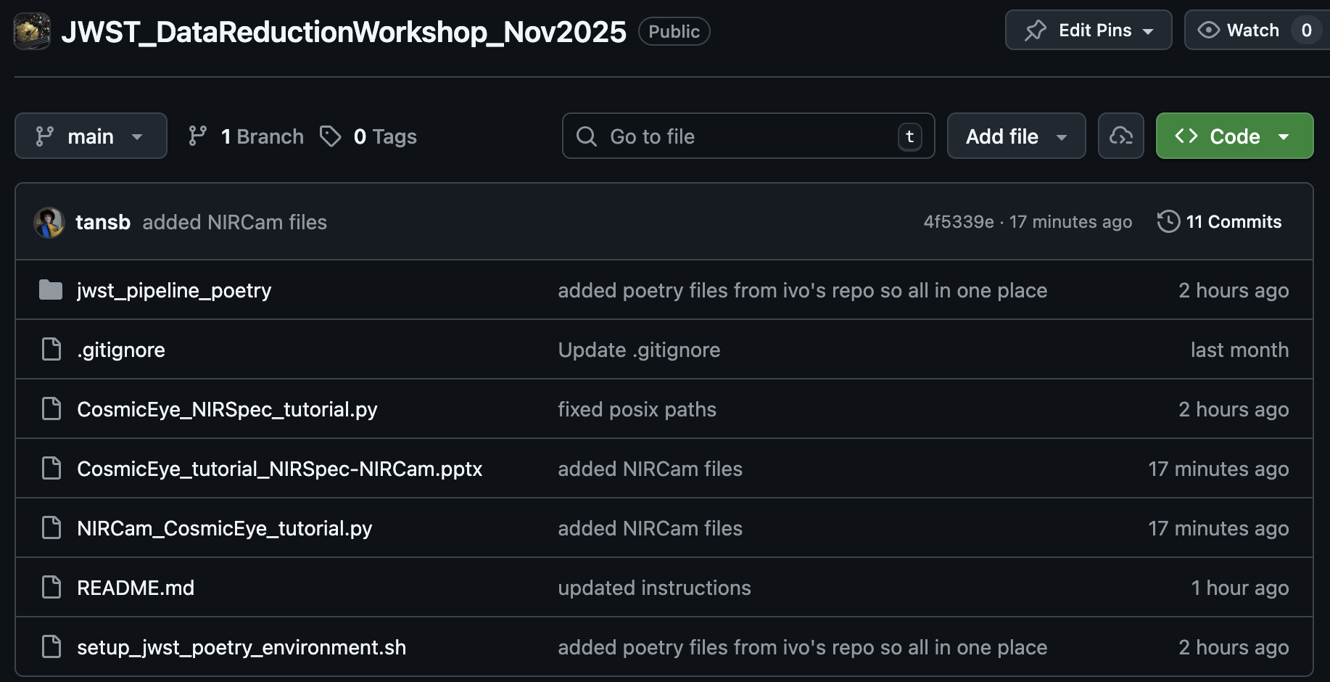
The reduction script

Slide 9
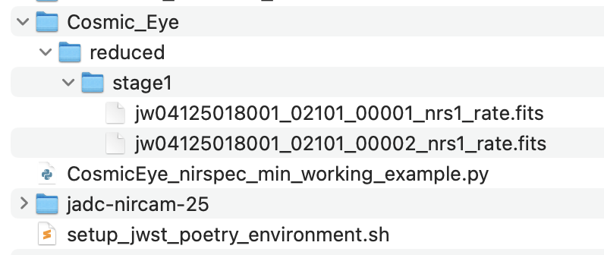
Set up directories

Slide 10
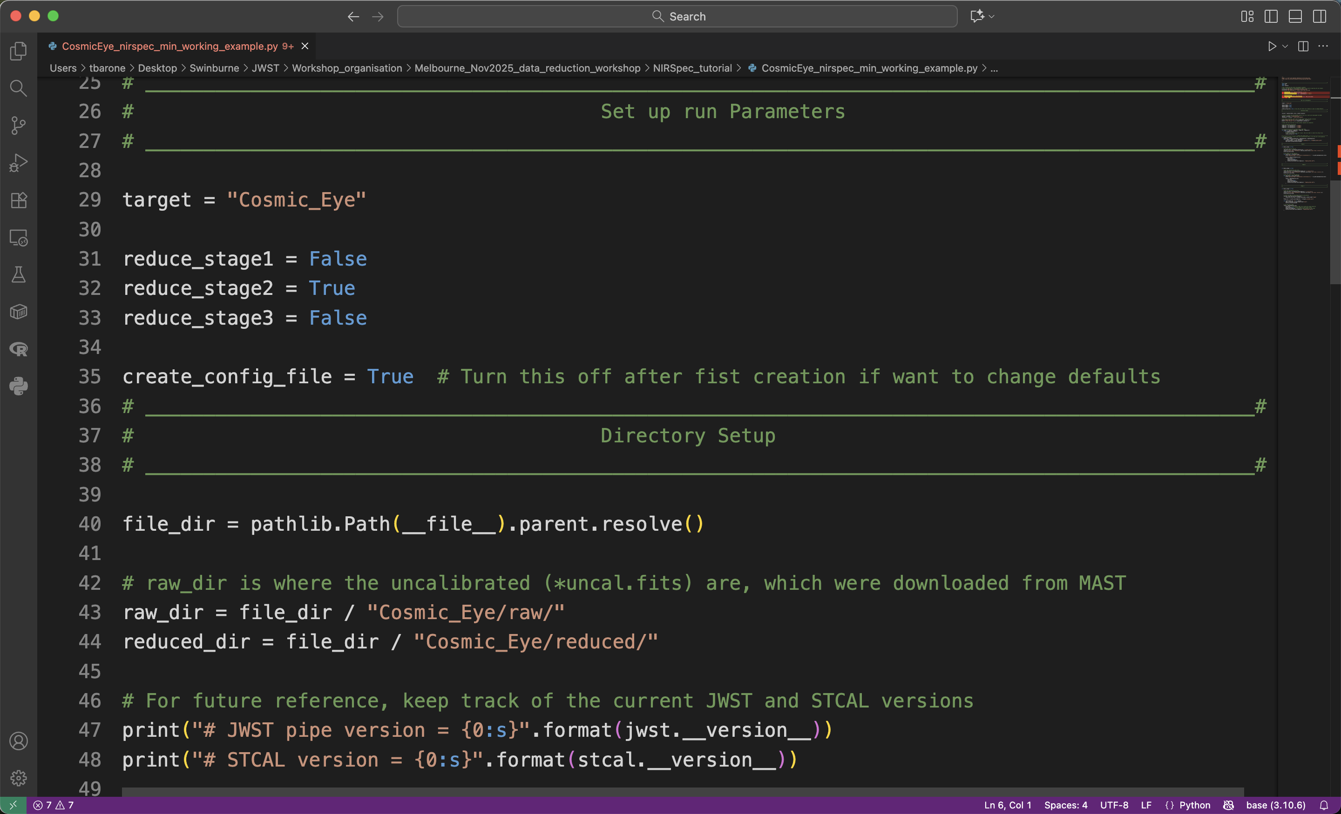
Set up paths and reduction steps
Try stage 1 in own time on _uncal.fits files.
Warning: The first run will take hours to download reference files!
On first run, create config files. If want to change defaults on reruns, switch to False
Check directory paths

Slide 11
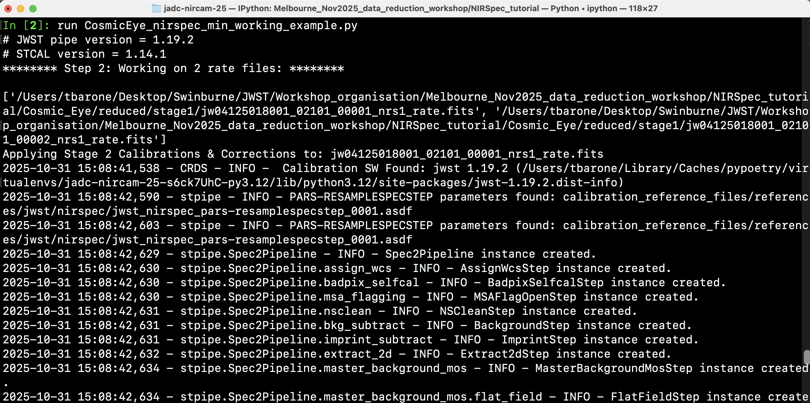
Running stages 1 and 2

Slide 12
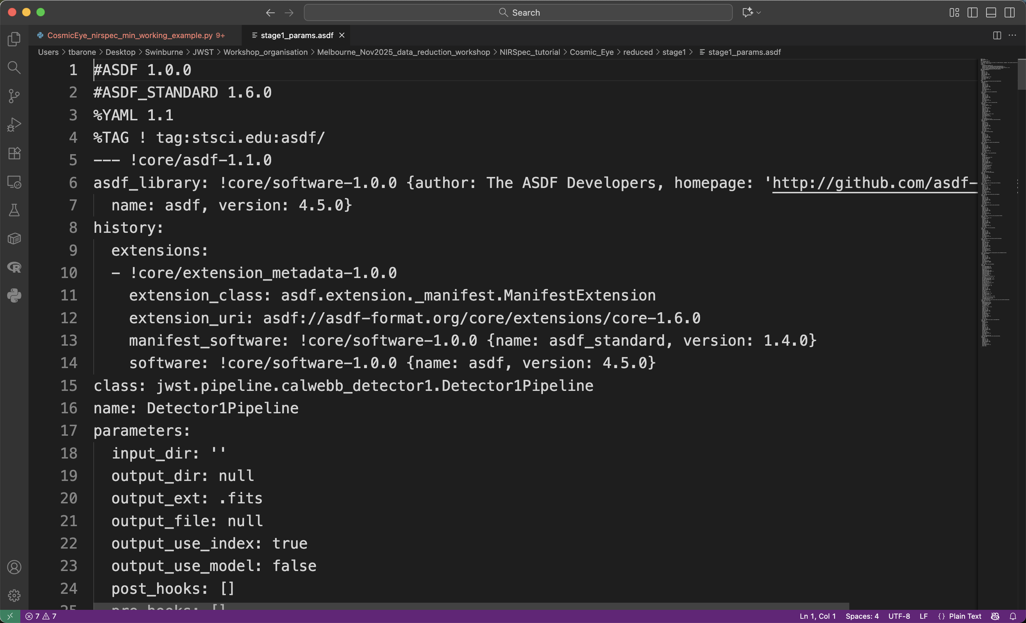
Modifying reduction parameters: ASDF files

Slide 13
NIRCam Imaging

Slide 14
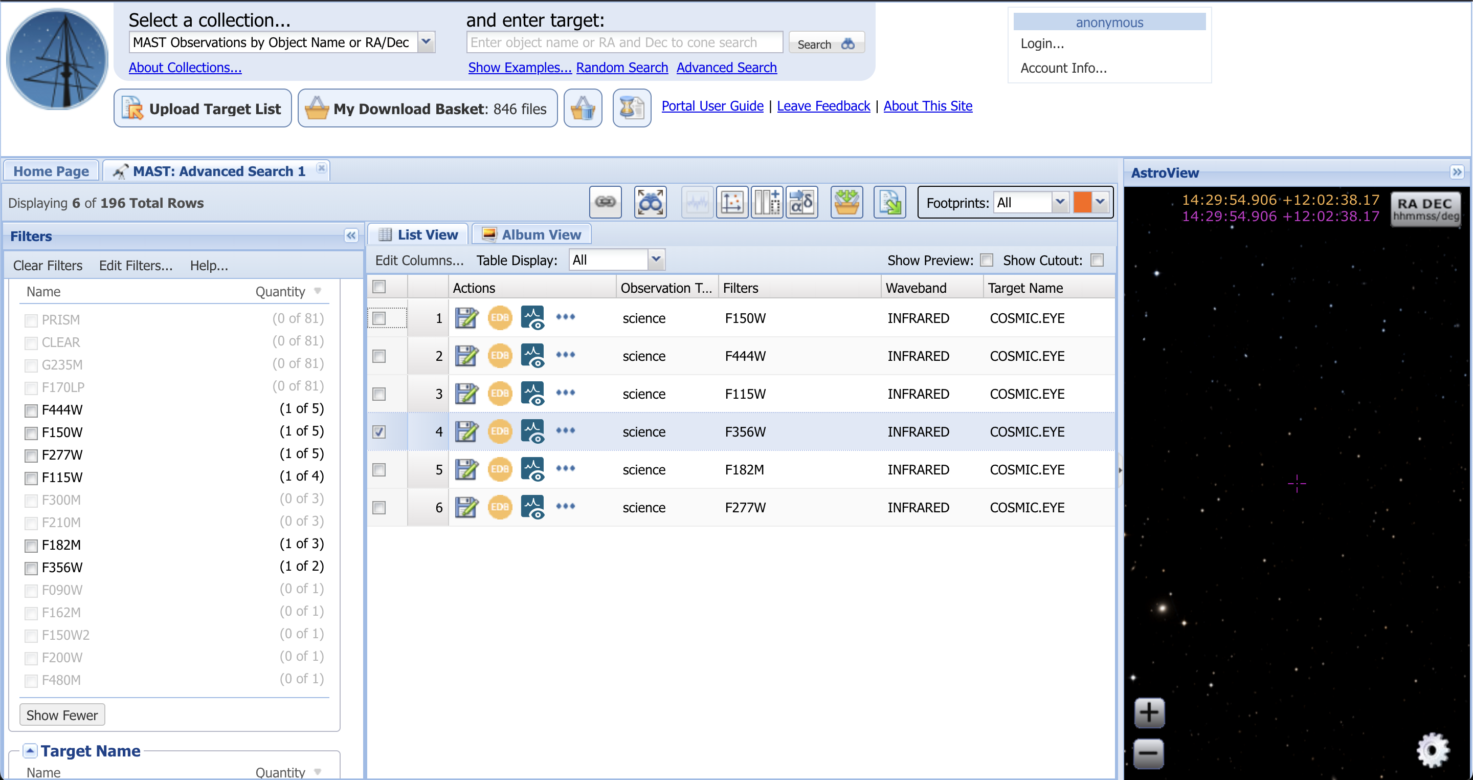
Retrieve data from MAST
Select F356W filter
There are 4 dithers = jw04125018001_02101_0000X_nrs2 for X = 1-4
Fully reduced cube = jw04125-o018_t039_nirspec_g235m-f170lp

Slide 15
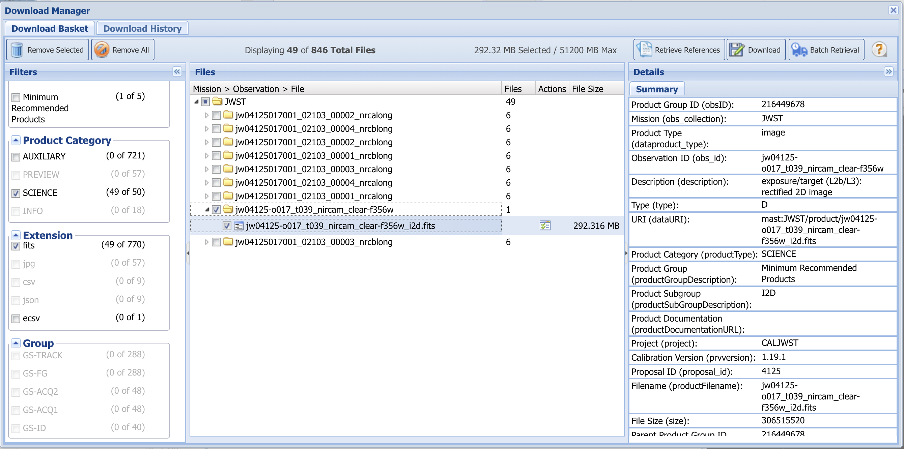
Download the reduced cube
Filename =jw04125-o017_t039_nircam_clear-f356w_i2d.fits
JWST proposal ID
Association candidate ID
Target ID
Instrument, grating, filter
filetype (2d image)
File naming convention: https://jwst-pipeline.readthedocs.io/en/latest/jwst/data_products/file_naming.html

Slide 16
Download the raw* exposures
Raw (stage 0 from the telescope) = _uncal.fits
Stage 1 produces _rates.fits
Stage 2 produces _cal.fits
Stage 3 produces _i2d.fits
Stage 1 of the pipeline requires GBs of reference files, will take too long to download so we’ll start at stage 2. Download _rates.fits files
NIRCam has two long wavelength detectors. So will need to download both nrcalong and nrcblong files.
To speed up downloads and reduction, only download the first two exposures (1 – 2):
jw04125017001_02103_00001_nrcalong_rate.fits
JWST proposal ID
Observation number
Visit number
visit group, sequence,
Exposure number
Detector
File type
Notes:
jw04125017001_02103_00002_nrcalong_rate.fits

Slide 17
The reduction script

Slide 18
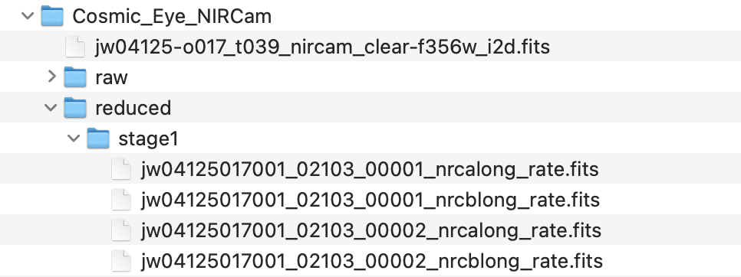
Set up directories

